Slide 1
Centrality in networks
Closeness and Betweenness

Slide 2
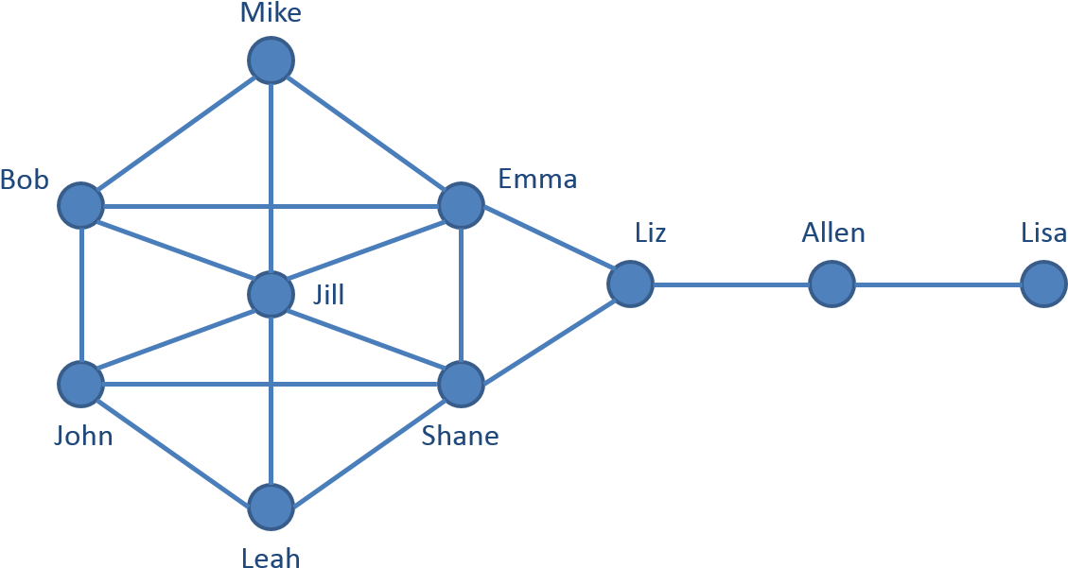
“Central” Nodes
A typical question about a network is “Which are the most important or central nodes in a network?” There are many possible approaches to measuring “centrality” that capture its different aspects.
Which are the most central nodes on this network?
Notes:
Degree: Jill
Closeness: Emma and Shane
Betweenness: Liz

Slide 3
Three Approaches
Closeness centrality. The importance of a node is determined by how close it is to the other nodes.
Betweenness centrality. The importance of a node is determined by its control over paths in the network.
Degree centrality.
Eigenvector centrality.
Google’s PageRank.
HITS ranking.
The importance of a node is determined by how many neighbors it has and how important the neighbors are.
Notes:
Closeness centrality (section 7.1.6)
Betweenness centrality (section 7.1.7)
Degree centrality (section 7.1.1)
Eigenvector centrality (section 7.1.2)
Google’s PageRank (section 7.1.4)
HITS ranking (section 7.1.5)

Slide 4

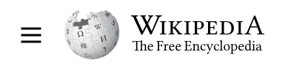
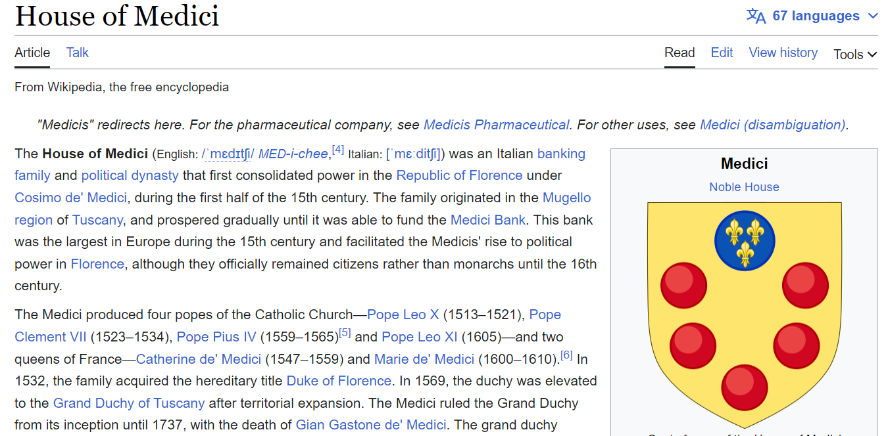
Example: House of Medici
popular book (1974)
Netflix TV show (2016)
Cosimo de' Medici
1389–1464
Piero de' Medici
1416–1469
Lorenzo de' Medici
1449–1492
Notes:
https://www.youtube.com/watch?v=xRrZOQBF_k4
https://www.youtube.com/watch?v=emAMMXQrKqE&t=81s

Slide 5
The Republic of Florence, 15th Century
In the beginning of the 15th century, Florence was ruled by an oligarchy of wealthy aristocratic families. The Medici family had less wealth and political clout than other families in the oligarchy.
However, the Medici (with Cosimo de‘ Medici playing the key role) rose in power and consolidated control of the business and politics of Florence. They essentially control the city from behind the scenes.

Slide 6
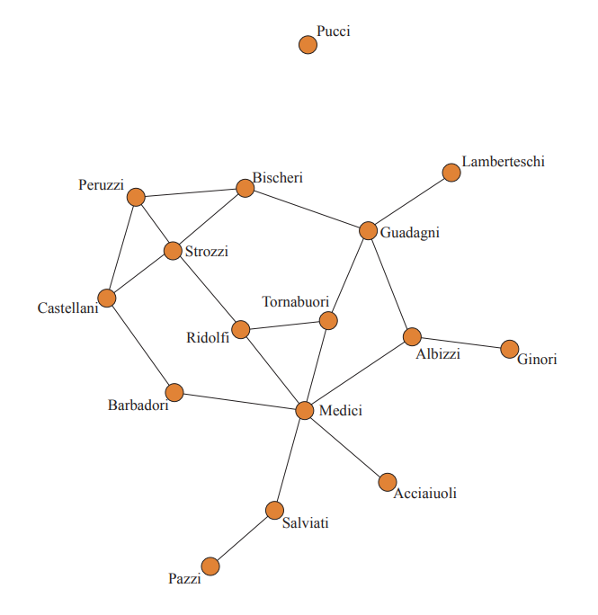
How Did the Medici Take Control?
The Medici used various tools for gaining power and one of them was to occupy “central” positions in the network of family inter-marriages.
Marriage relationships between families were keys to communicating information, brokering business deals, and reaching political decisions.

Slide 7
Closeness Centrality

Slide 8
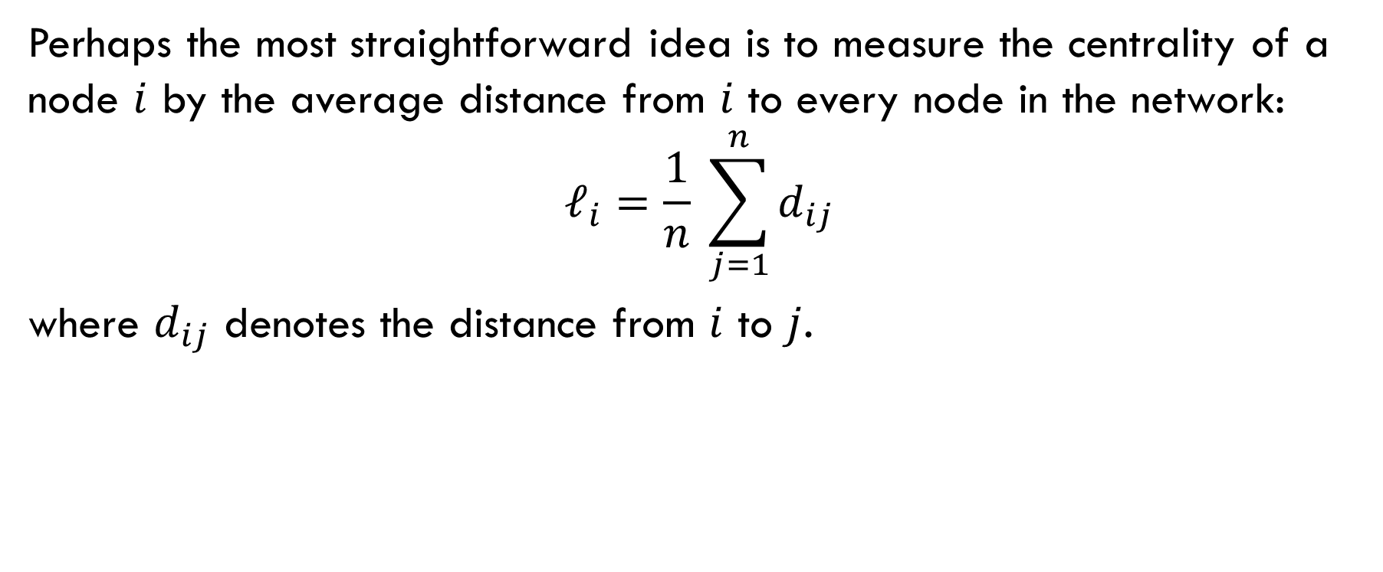
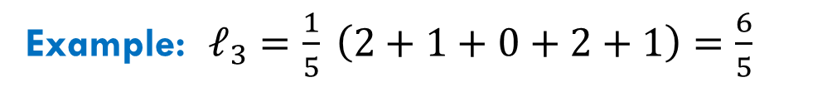
Idea
Perhaps the most straightforward idea is to measure the centrality of a node $i$ by the average distance from $i$ to every node in the network:
$$ℓ_{i}=\frac{1}{n} \sum_{j=1}^{n}{d_{ij}}$$
where $d_{ij}$ denotes the distance from $i$ to $j$.
Example: $ℓ_{3}=\frac{1}{5} \left(2+1+0+2+1\right)=\frac{6}{5}$

Slide 9
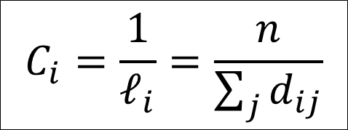
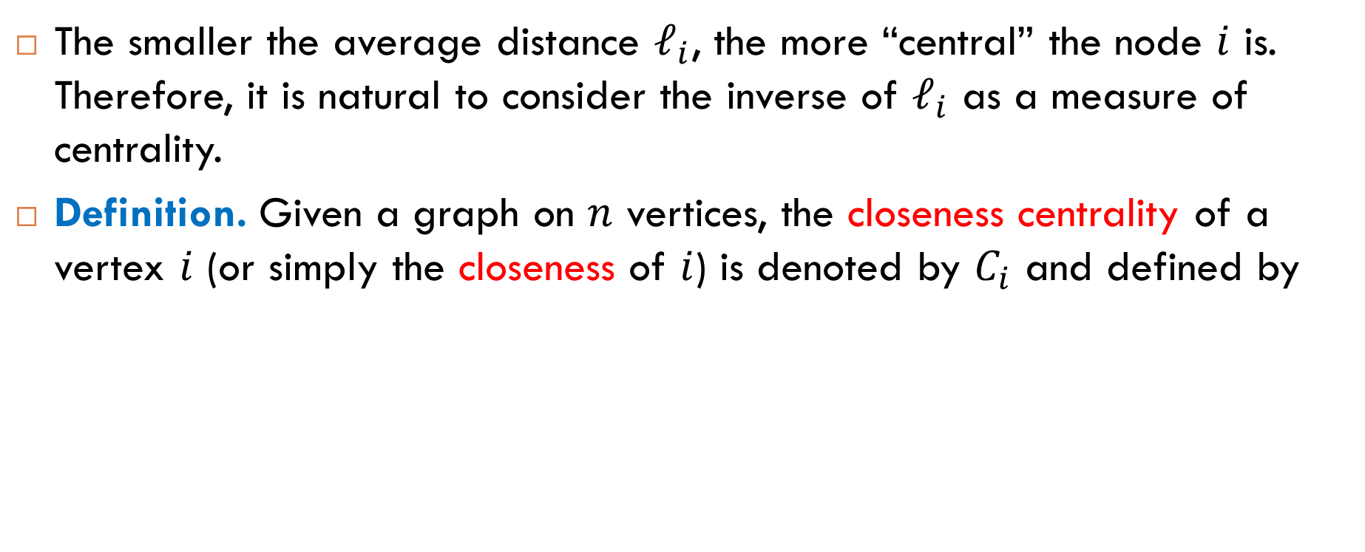
Definition of Closeness Centrality
The smaller the average distance $ℓ_{i}$, the more “central” the node $i$ is. Therefore, it is natural to consider the inverse of $ℓ_{i}$ as a measure of centrality.
Definition. Given a graph on $n$ vertices, the closeness centrality of a vertex $i$ (or simply the closeness of $i$) is denoted by $C_{i}$ and defined by
$$C_{i}=\frac{1}{ℓ_{i}}=\frac{n}{\sum_{j}{d_{ij}}}$$

Slide 10
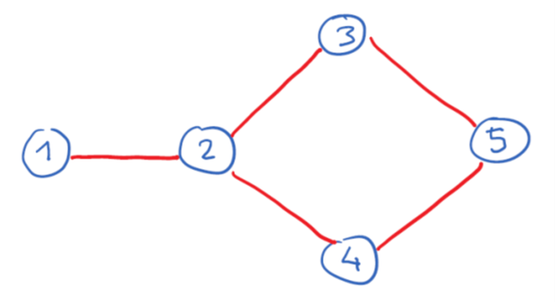
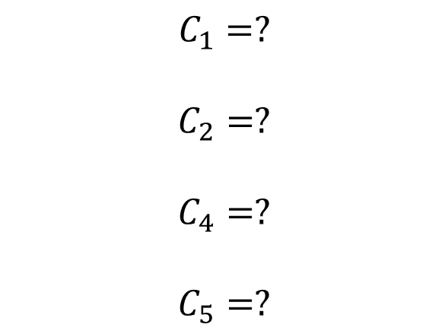
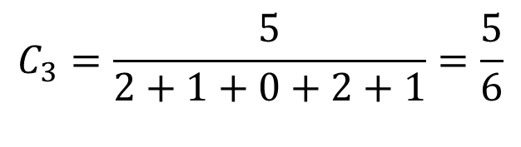
Exercise
$$C_{1}=?$$
$$C_{2}=?$$
$$C_{4}=?$$
$$C_{5}=?$$
$$C_{3}=\frac{5}{2+1+0+2+1}=\frac{5}{6}$$

Slide 11
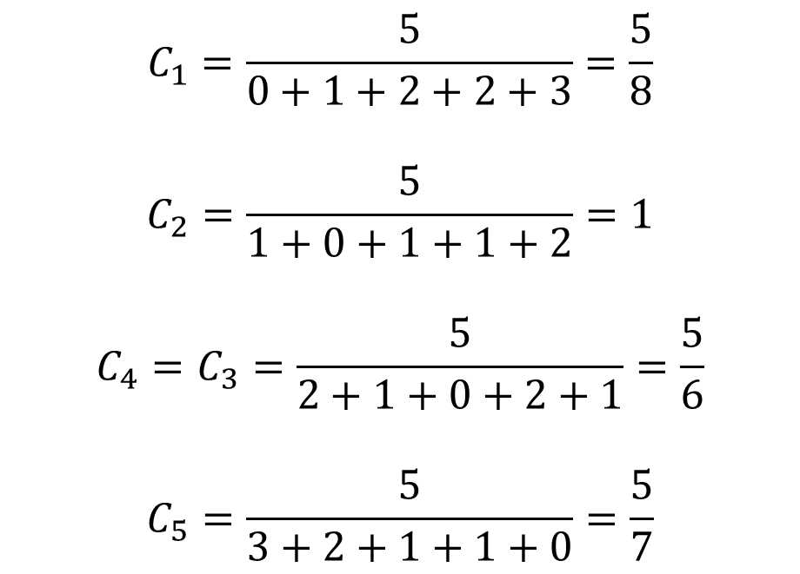
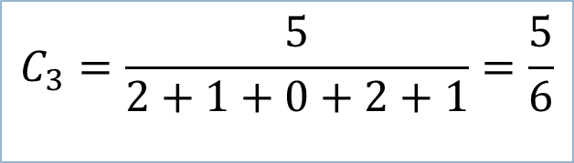
Exercise: Solution
$$C_{1}=\frac{5}{0+1+2+2+3}=\frac{5}{8}$$
$$C_{2}=\frac{5}{1+0+1+1+2}=1$$
$$C_{4}=C_{3}=\frac{5}{2+1+0+2+1}=\frac{5}{6}$$
$$C_{5}=\frac{5}{3+2+1+1+0}=\frac{5}{7}$$
$$C_{3}=\frac{5}{2+1+0+2+1}=\frac{5}{6}$$

Slide 12
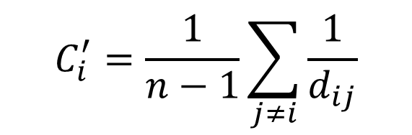
Good Measure?
The closeness can be used in some applications, but it is not a good measure of centrality for two reasons.
Connectivity. The definition makes sense only for connected graphs. Even if we adjust the definition for components, there is a problem with small components. One way to get around this problem is to consider the inverse distance:
Closeness values are not well separated. This reason is more serious.
$$C_{i}^{′}=\frac{1}{n−1}\sum_{j≠i}{\frac{1}{d_{ij}}}$$

Slide 13
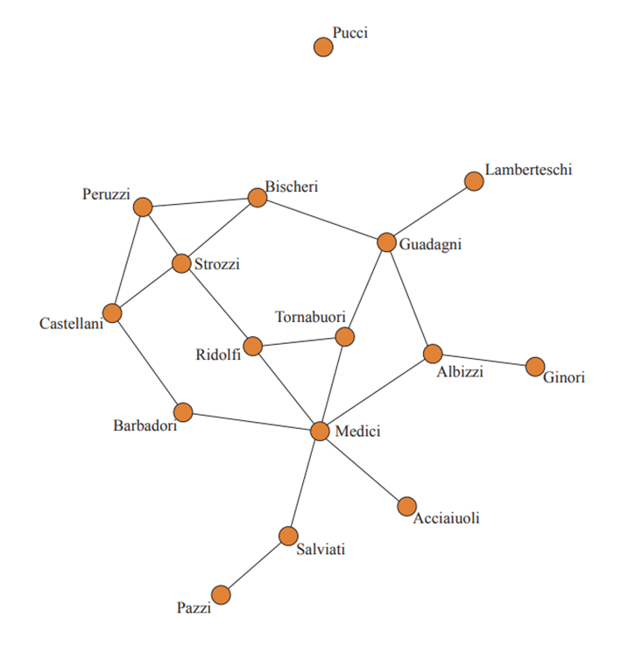
Closeness Values of Florentine Families
Medici | 0.560
Ridolfi | 0.500
Albizzi | 0.483
Tornabuoni | 0.483
Guadagni | 0.467
Barbadori | 0.438
Strozzi | 0.438
Bischeri | 0.400
Castellani | 0.389
Salvati | 0.389
Acciaiouli | 0.368
Peruzzi | 0.368
Ginori | 0.333
Lamberteschi | 0.326
Pazzi | 0.286
The closeness centrality has an issue in typical social networks: its values are very closely spaced. This is caused by the small-world property of social networks.

Slide 14
Another Example: Co-Stardom
What is the star with the highest closeness centrality?
The closeness centrality of Christopher Lee is 0.413 (calculated using the largest component that includes about 98% of all actors). He had a long career and appeared in more than 200 films.
Sir Christopher Lee
1922–2015

Slide 15
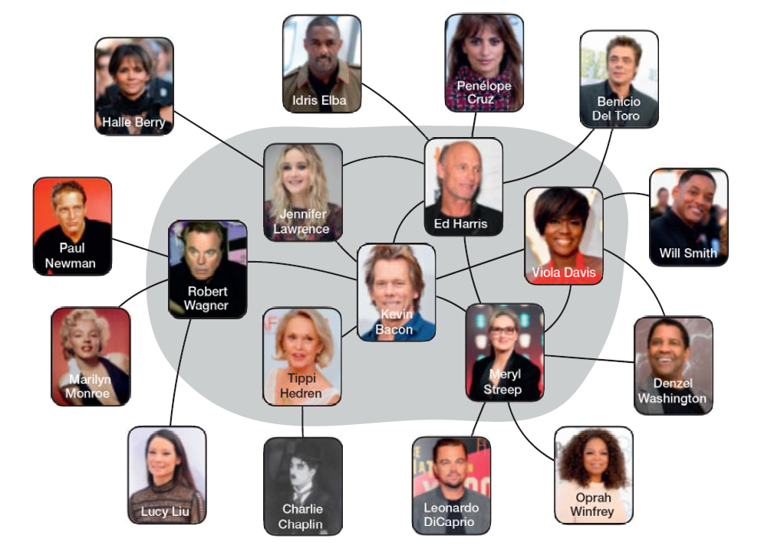
Collaboration Networks: Bacon Number
Co-stardom network
Nodes are movie stars; two nodes are connected by an edge if they co-starred (performed) in the same movie.
Data collection
IMDB, Wikipedia.
Bacon number
The Bacon number of a node is its collaboration distance from Kevin Bacon.
Bacon number online calculator: https://oracleofbacon.org/

Slide 16
Betweenness Centrality

Slide 17
Idea of Betweenness Centrality
Flows. In the definition of betweenness centrality, a network is viewed as a graph of flows: vertices are connected by paths along which something flows. A typical example of flow in a social network is information (messages, news, rumors, etc.) passed from one person to another.
Shortest paths. The standard assumption is that a flow between two vertices always takes shortest paths between them. Thus, vertices that lie on shortest paths can control flow passing.
Control over shortest paths. Betweenness centrality measures the extent to which a vertex lies on shortest paths between other vertices.

Slide 18
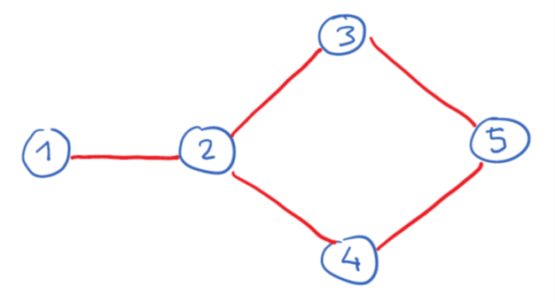
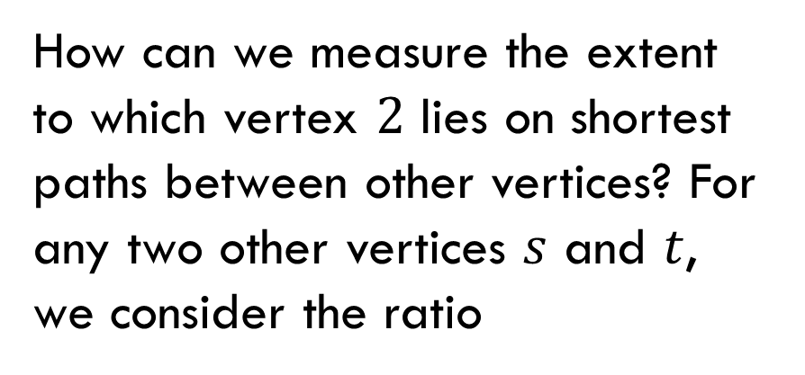
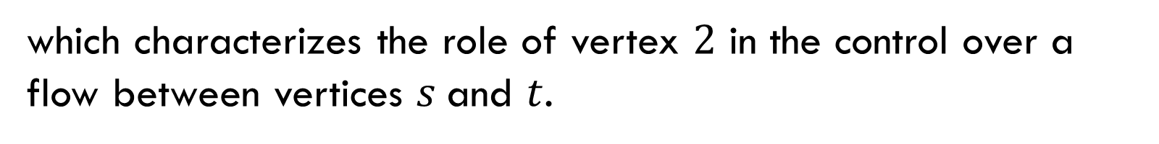
Example
How can we measure the extent
to which vertex $2$ lies on shortest paths between other vertices? For any two other vertices $s$ and $t$, we consider the ratio
$$\frac{\text{number} \text{of} \text{shortest} \text{paths} \text{between} s \text{and} t \text{that} \text{pass} \text{through} \text{vertex} 2}{\text{total} \text{number} \text{of} \text{shortest} \text{paths} \text{between} s \text{and} t}$$
which characterizes the role of vertex $2$ in the control over a flow between vertices $s$and $t$.

Slide 19

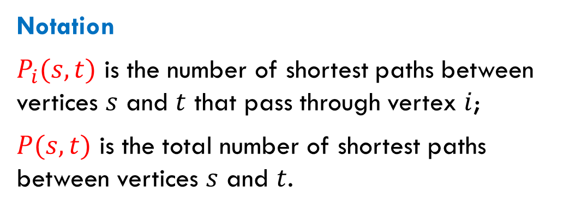
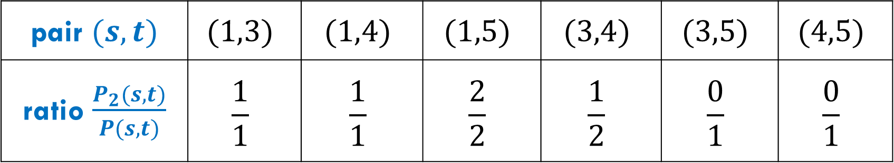
Example (cont.)
Notation
$P_{i}(s,t)$ is the number of shortest paths between vertices $s$ and $t$ that pass through vertex $i$;
$P(s,t)$ is the total number of shortest paths between vertices $s$ and $t$.
pair $(s,t)$ | $$(1,3)$$ | $$(1,4)$$ | $$(1,5)$$ | $$(3,4)$$ | $$(3,5)$$ | $$(4,5)$$
ratio $\frac{P_{2}(s,t)}{P(s,t)}$ | $$\frac{1}{1}$$ | $$\frac{1}{1}$$ | $$\frac{2}{2}$$ | $$\frac{1}{2}$$ | $$\frac{0}{1}$$ | $$\frac{0}{1}$$

Slide 20
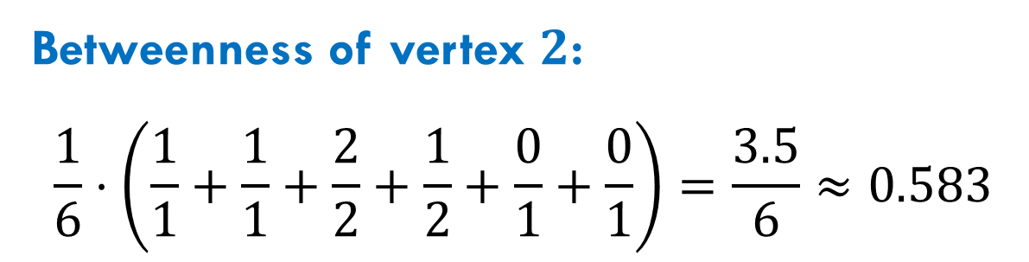

Example (cont.)
pair $(s,t)$ | $$(1,3)$$ | $$(1,4)$$ | $$(1,5)$$ | $$(3,4)$$ | $$(3,5)$$ | $$(4,5)$$
ratio $\frac{P_{2}(s,t)}{P(s,t)}$ | $$\frac{1}{1}$$ | $$\frac{1}{1}$$ | $$\frac{2}{2}$$ | $$\frac{1}{2}$$ | $$\frac{0}{1}$$ | $$\frac{0}{1}$$
Betweenness of vertex $2$:
$$\frac{1}{6}⋅\left(\frac{1}{1}+\frac{1}{1}+\frac{2}{2}+\frac{1}{2}+\frac{0}{1}+\frac{0}{1}\right)=\frac{3.5}{6}≈0.583$$

Slide 21
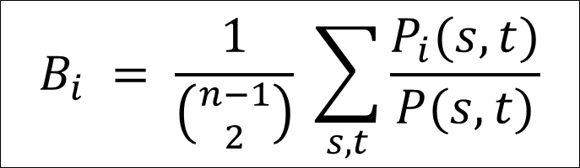
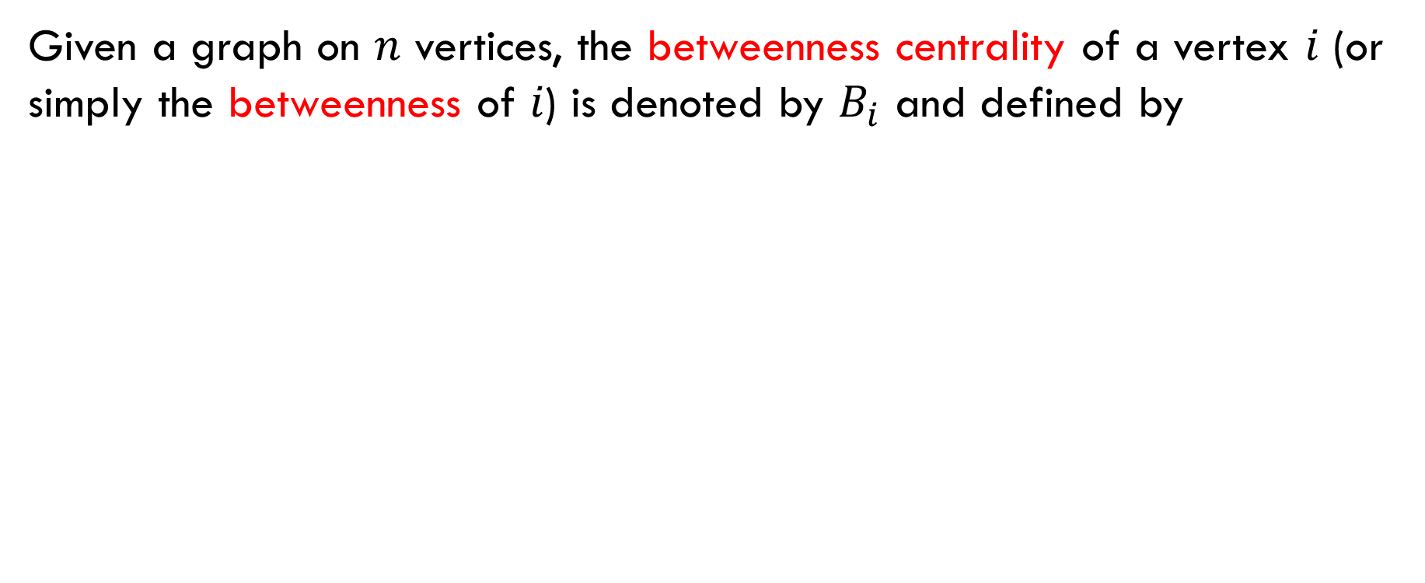
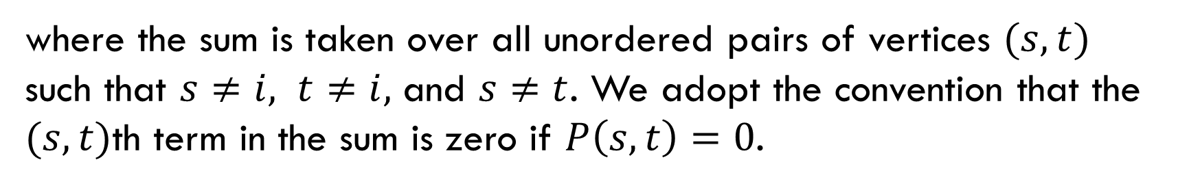
Definition of Betweenness Centrality
Given a graph on $n$ vertices, the betweenness centrality of a vertex 𝑖 (or simply the betweenness of 𝑖) is denoted by $B_{i}$ and defined by
$$B_{i} = \frac{1}{\left({n−1 \atop 2}\right)} \sum_{s,t}{\frac{P_{i}(s,t)}{P(s,t)}}$$
where the sum is taken over all unordered pairs of vertices $(s, t)$ such that $s≠i, t≠i,$ and $s≠t$. We adopt the convention that the $(s,t)$th term in the sum is zero if $P\left(s,t\right)=0$.

Slide 22

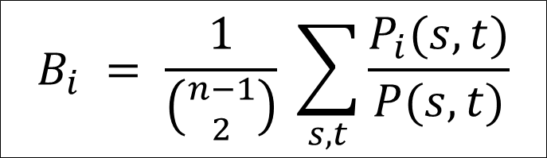

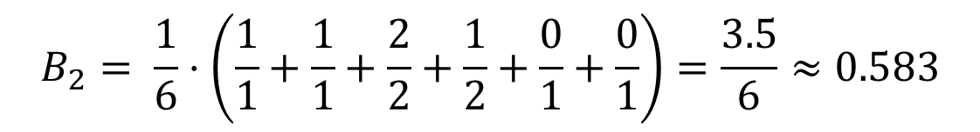
Exercise
$$B_{i} = \frac{1}{\left({n−1 \atop 2}\right)} \sum_{s,t}{\frac{P_{i}(s,t)}{P(s,t)}}$$
$$B_{2}= \frac{1}{6}⋅\left(\frac{1}{1}+\frac{1}{1}+\frac{2}{2}+\frac{1}{2}+\frac{0}{1}+\frac{0}{1}\right)=\frac{3.5}{6}≈0.583$$
Calculate yourself: $B_{1}, B_{3}, B_{4}, B_{5}$.

Slide 23

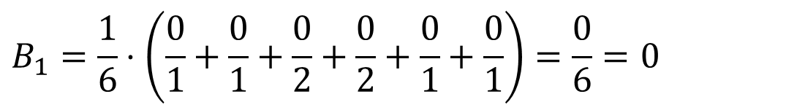
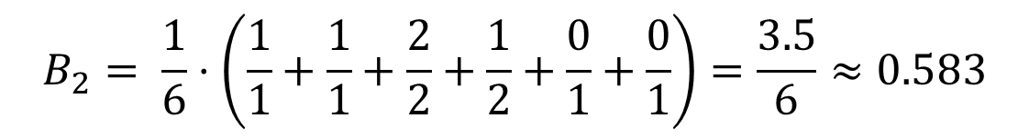
Exercise: $B_{1}$
$$B_{i} = \frac{1}{\left({n−1 \atop 2}\right)} \sum_{s,t}{\frac{P_{i}(s,t)}{P(s,t)}}$$
$$B_{2}= \frac{1}{6}⋅\left(\frac{1}{1}+\frac{1}{1}+\frac{2}{2}+\frac{1}{2}+\frac{0}{1}+\frac{0}{1}\right)=\frac{3.5}{6}≈0.583$$
$$B_{1}=\frac{1}{6}⋅\left(\frac{0}{1}+\frac{0}{1}+\frac{0}{2}+\frac{0}{2}+\frac{0}{1}+\frac{0}{1}\right)=\frac{0}{6}=0$$

Slide 24

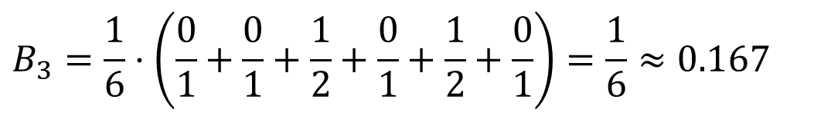
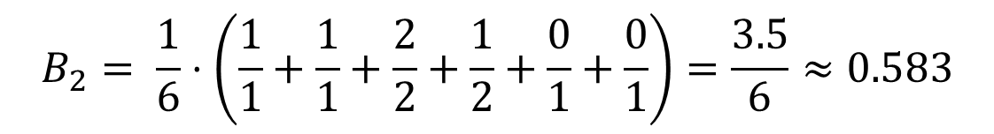
Exercise: $B_{3}$
$$B_{i} = \frac{1}{\left({n−1 \atop 2}\right)} \sum_{s,t}{\frac{P_{i}(s,t)}{P(s,t)}}$$
$$B_{2}= \frac{1}{6}⋅\left(\frac{1}{1}+\frac{1}{1}+\frac{2}{2}+\frac{1}{2}+\frac{0}{1}+\frac{0}{1}\right)=\frac{3.5}{6}≈0.583$$
$$B_{3}=\frac{1}{6}⋅\left(\frac{0}{1}+\frac{0}{1}+\frac{1}{2}+\frac{0}{1}+\frac{1}{2}+\frac{0}{1}\right)=\frac{1}{6}≈0.167$$

Slide 25

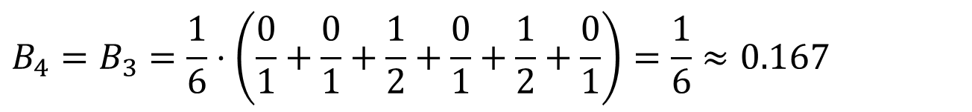
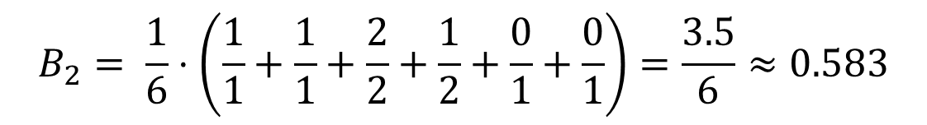
Exercise: $B_{4}$
$$B_{i} = \frac{1}{\left({n−1 \atop 2}\right)} \sum_{s,t}{\frac{P_{i}(s,t)}{P(s,t)}}$$
$$B_{2}= \frac{1}{6}⋅\left(\frac{1}{1}+\frac{1}{1}+\frac{2}{2}+\frac{1}{2}+\frac{0}{1}+\frac{0}{1}\right)=\frac{3.5}{6}≈0.583$$
$$B_{4}=B_{3}=\frac{1}{6}⋅\left(\frac{0}{1}+\frac{0}{1}+\frac{1}{2}+\frac{0}{1}+\frac{1}{2}+\frac{0}{1}\right)=\frac{1}{6}≈0.167$$

Slide 26

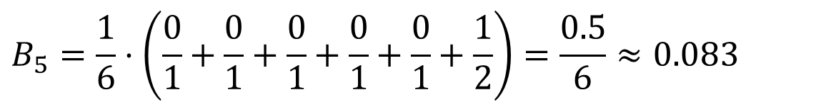
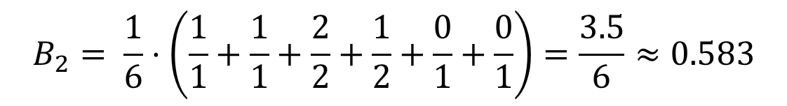
Exercise: $B_{5}$
$$B_{i} = \frac{1}{\left({n−1 \atop 2}\right)} \sum_{s,t}{\frac{P_{i}(s,t)}{P(s,t)}}$$
$$B_{2}= \frac{1}{6}⋅\left(\frac{1}{1}+\frac{1}{1}+\frac{2}{2}+\frac{1}{2}+\frac{0}{1}+\frac{0}{1}\right)=\frac{3.5}{6}≈0.583$$
$$B_{5}=\frac{1}{6}⋅\left(\frac{0}{1}+\frac{0}{1}+\frac{0}{1}+\frac{0}{1}+\frac{0}{1}+\frac{1}{2}\right)=\frac{0.5}{6}≈0.083$$

Slide 27
Betweenness Values of Florentine Families
Medici | 0.522
Guadagni | 0.255
Albizzi | 0.212
Salvati | 0.143
Ridolfi | 0.114
Bischeri | 0.104
Strozzi | 0.103
Barbadori | 0.093
Tornabuoni | 0.092
Castellani | 0.055
Peruzzi | 0.022
other families | 0
In contrast to closeness, the betweenness measure typically tends to be well separated.

Slide 28
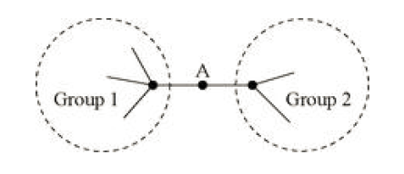
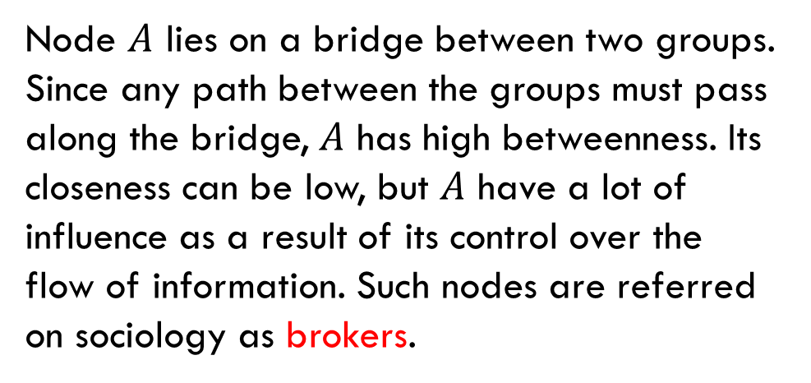
Why “Betweenness”?
Closeness centrality measures how much a node is connected with others. Betweenness centrality measures how much a node falls “between” others. A node can be a long way from others on average and still have high betweenness.
Node $A$ lies on a bridge between two groups. Since any path between the groups must pass along the bridge, $A$ has high betweenness. Its closeness can be low, but $A$ have a lot of influence as a result of its control over the flow of information. Such nodes are referred on sociology as brokers.

Slide 29
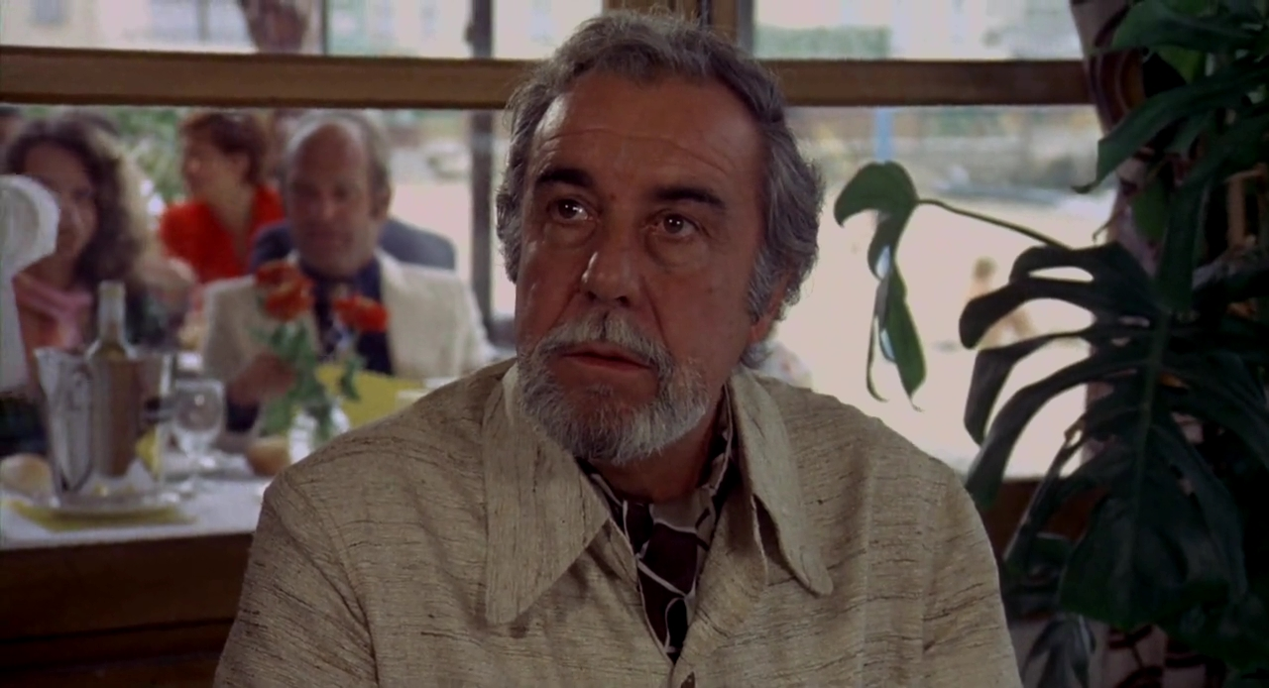
Highest Betweenness in Co-Stardom
According to the IMDB data in 2001, Christopher Lee had the highest closeness and the second highest betweenness in Co-Stardom. Who had the highest betweenness?
Mark Newman (from the textbook, page 176):
It is perhaps no coincidence that the highest betweenness belongs to an actor who appeared in both European and American films, played roles in several different languages, and worked extensively in both film and television, as well as on stage. Rey was the archetypal broker, a crucial link between different branches of the entertainment industry.
Fernando Rey
1917–1994

Slide 30
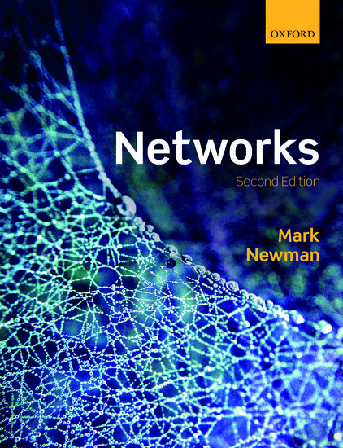
Reading
Sections 7.1.6-7.1.7

